Slide 1
INTRODUCTION TO DATA SCIENCE - FINAL PROJECT
Music Playlist Recommendation Engine
An End-to-End Data Science Pipeline | Phase 1 . Phase 2 . Phase 3
AmirMohammad Barari 810102408
AmirHossein Alikhani 810102479
Sadra Madayeni 810102564
Introduction to Data Science | Final Project

Slide 2
01
Phase 1: Dataset Selection
Choosing the right data foundation for a hyper-personalized recommendation engine

Slide 3
Phase 1: Dataset Overview
* Dataset: Spotify Tracks - sourced from Kaggle / Spotify Web API
o ~114,000 tracks spanning 114 genre categories (each 1000)
o 21 raw audio features per track (danceability, energy, valence, tempo, etc.)
o Additional metadata: artist name, album, popularity, duration, explicit flag
* Goal: Build a hyper-personalized music playlist recommender
o Predict the next track a user wants based on their listening session history
o Surface distinct listening vibes - e.g., High-Energy Electronic vs. Acoustic & Chill
Music Playlist Recommendation Engine

Slide 4
02
Phase 2: Database, EDA, Pipeline & CI/CD
Structuring data, understanding it deeply, automating workflows, and shipping with confidence

Slide 5
Phase 2 Section 1: EDA & Preprocessing
* General structure analysis: shape, dtypes, null counts, duplicates
* Distribution plots for all 21 numeric features (seaborn histplots & KDE)
o Identified heavy right-skew in speechiness, instrumentalness, liveness
o Tempo normalized to 0-1 range; loudness standardized from -60 dB to 0 dB
* Outlier detection using IQR method across all numeric columns
* Genre frequency analysis: top 20 genres vs. long-tail rare genres
* Genre Similarity Matrix computed: cosine similarity between all 114 genre centroids
o Key insight: grunge and metal have 0.999 similarity; disco and synth-pop have 0.999
o disco and latin 0.996, psych-rock and blues 0.996 - used to inform penalty system
* Correlation heatmap: danceability <-> valence, energy <-> loudness strongly correlated
* EDA plots saved to eda_plots/ directory for documentation
Music Playlist Recommendation Engine

Slide 6
Phase 2 Section 2: Database Implementation
* Database: SQLite via SQLAlchemy ORM - chosen for simplicity and portability
* Schema Design - Two-Table Relational Model:
o genres (id PK, name UNIQUE): one row per distinct music genre
o tracks (id PK, track_id, artists, album, audio features, genre_id FK)
* import_to_db.py: Automated ingestion pipeline
o Reads raw dataset.csv with Pandas
o Populates genres table first, retrieves auto-generated IDs
o Maps genre strings to integer foreign keys, then bulk-inserts all tracks
* database_connection.py: Shared engine factory used across all scripts
* load_data.py: Queries DB into DataFrames for downstream processing
Music Playlist Recommendation Engine

Slide 7
Phase 2 Section 3: Feature Engineering
* 4 Custom Composite Audio Indices created in feature_engineering.py:
o Intensity Index = (energy x 0.4) + (loudness_norm x 0.3) + (tempo_norm x 0.3)
o Groove Index = (danceability x 0.5) + (energy x 0.3) + (valence x 0.2)
o Euphoria Index = (valence x 0.5) + (danceability x 0.3) + (energy x 0.2)
o Electronic Index = (energy x 0.4) + (1-acousticness x 0.4) + (danceability x 0.2)
* StandardScaler applied to all 8 final feature columns for ML compatibility
* Genre Similarity Matrix (114x114): cosine similarity between genre centroids
o Enables intelligent cross-genre recommendations (e.g., disco -> latin -> synth-pop)
o Saved to genre_similarity_matrix.csv for reuse in playlist generator
* Deduplication: tracks assigned to best-fit genre based on centroid distance
o Removed >30% dataset bloat from multi-genre duplicate entries
Music Playlist Recommendation Engine

Slide 8
End-to-End Pipeline Architecture
1 Data Ingestion
2 Preprocess & EDA
3 Feature Engineering
4 Clustering (Vibes)
5 Deduplicate Dataset
6 LSTM Training
7 Playlist Generation
->
->
->
->
->
->
Orchestration
Database
Model
Tracking
CI/CD
Prefect @flow & @task Automatic retries Visual graphs
SQLite via SQLAlchemy Relational schema Genres + Tracks tables
PyTorch LSTM Attention Mechanism 40,000+ sequences
MLFlow Hyperparams + Metrics Model .pth artifacts
GitHub Actions Auto regression tests Docker + Kubernetes
Music Playlist Recommendation Engine

Slide 9
Phase 2 Section 4: Prefect Pipeline Orchestration
* run_pipeline.py: Master orchestrator using Prefect @flow and @task decorators
* 7 pipeline stages wrapped as individual Prefect Tasks:
o @task Data Import -> Preprocess -> Feature Engineering -> Clustering
o -> Deduplicate -> Train LSTM -> Generate Playlists
* Automatic Retry Logic: Data Import task retries=2 with 10s delay on failure
* Sequential dependency enforcement: if step N fails, step N+1 never runs
* Prefect Dashboard: prefect server start -> localhost:4200
o Visual flowchart of task execution graph
o Per-task runtime, success/failure indicators, and historical run logs
o Schedule-on-demand: run pipeline on CRON schedule via UI
Music Playlist Recommendation Engine

Slide 10
03
Phase 3: Model Development & Playlist Generation
Training a sequence-aware LSTM and generating hyper-personalized recommendations

Slide 11
Phase 3 Section 1: LSTM Neural Network
* Model: SessionRecommenderLSTM (PyTorch)
o Input: sequences of 5 tracks x 8 audio features -> shape [batch, 5, 8]
o LSTM Layer: 8 -> 32 hidden dimensions, 1 layer, batch_first=True
o Custom Attention: Linear(32, 1) + softmax -> weighted context vector
o Output Layer: Linear(32, 8) -> predicts audio features of next track
* Training Data: 40,000 sequences from 49,000+ real Spotify user playlists
o Built from cleaned_playlists.csv - authentic human listening sequences
o Sliding window of 5 tracks, target = track at position 6
* Optimizer: Adam (lr=0.001) | Loss: MSELoss | Epochs: 5
* All runs tracked in MLFlow: hyperparams, per-epoch loss, saved .pth artifact
Music Playlist Recommendation Engine

Slide 12
Phase 3 Section 2: Dynamic Vibe Clustering
* Query input: user's recently played tracks (IDs in query.txt)
* Step 1 - PCA: reduces 8 audio features to 2D for visualization
* Step 2 - Metadata-Driven K Selection:
o Counts genres with 3+ tracks in the session
o Sets K = number of qualifying genres (minimum K=1, maximum K=6)
* Step 3 - KMeans clustering separates session into K distinct vibe groups
* Each cluster is labeled by its dominant genre (e.g., Grunge & Similar)
* query_clusters.png: scatter plot of 2D PCA clusters color-coded by vibe
* Result: enables targeted per-vibe recommendations instead of one global mix
Music Playlist Recommendation Engine

Slide 13
Phase 3 Section 3: Dynamic Percentage Genre Weighting
* Key innovation: weights calculated locally per cluster, not globally
o Dominant genre of cluster forced to weight = 1.0
* For each cluster, count tracks per genre -> local_genre_counts
o weight = count_in_cluster / total_tracks_in_cluster
* Genre Similarity Matrix for cross-genre scoring:
o 1st Top Similar Genre: 0.985
o 2nd Top Similar Genre: 0.980
o 3rd Top Similar Genre: 0.975
* Similar-but-not-played genres receive: base_weight - 0.15 penalty
o Prevents regional sub-genre hijacking of dominant genre mixes
Music Playlist Recommendation Engine

Slide 14
Phase 3 Section 4: Three Mix Types Generated
For You Mix
Vibe-Specific Mixes
Dedicated Artist Mixes
Global session prediction. LSTM encodes all query tracks and predicts best-matching tracks (based on the 8 audio features) from the full database. Scored by cosine similarity to LSTM output + artist loyalty bonus(any of their tracks in the database receive a +0.005 score bump. capped at a maximum bonus of +0.05) Played Genres: If a track belongs to a genre you played in your query, it gets a +0.005 bump per play, capped at +0.05.
Unplayed Penalty: If a track's genre was not played at all during your session, it is penalized with a -0.10 reduction.
One mix per detected cluster. Only searches within the cluster's dominant genre + top 3 similar genres. Genre weights applied: Dominant=1.0,
Top 3 =0.985, 0.98, 0975
Others: % of the genre in the cluster
Unplayed penalized -0.15.
Loyalty reward system. If user played 5+ tracks from one artist, a dedicated mix is spun off. Searches only that artist's discography, scored by LSTM cosine similarity between artist_centroid and the entire database.
Music Playlist Recommendation Engine

Slide 15
04
Real User Query Test
Eeal Spotify playlist tested end-to-end through the recommendation engine

Slide 16
Real User Test - Mix 8: Deeply Eclectic, 3 Vibes Detected
* Query: 34 tracks - show-tunes, metalcore, chill, psych-rock, dub, edm, acoustic, rock, hip-hop, trance...
* Vibes Detected: 3 (Psych-Rock, EDM, Acoustic) - system correctly split mixed session
* For You Mix top picks:
o Ball And Chain by Mike Ness (psych-rock, 1.00)
o The Pot by TOOL (metal, 0.98) - LSTM recognized the heavy/dark energy
* Psych-Rock Mix: 10 pure psych-rock tracks (UFO, Avalanches, Graveyard, Grinspoon)
* EDM Mix: 10 pure EDM tracks (MEDUZA, Galantis, Alesso, The Chainsmokers/ILLENIUM)
* Acoustic Mix: Japanese, folk-punk, indie acoustic
o Aimyon x2 (Japanese acoustic), Days N Daze, AJJ - proves no genre bias
* Dedicated Artist Mixes: None triggered
* Verdict: Strongest test - 3 completely different vibes separated correctly, 0 genre bleed
Music Playlist Recommendation Engine

Slide 17
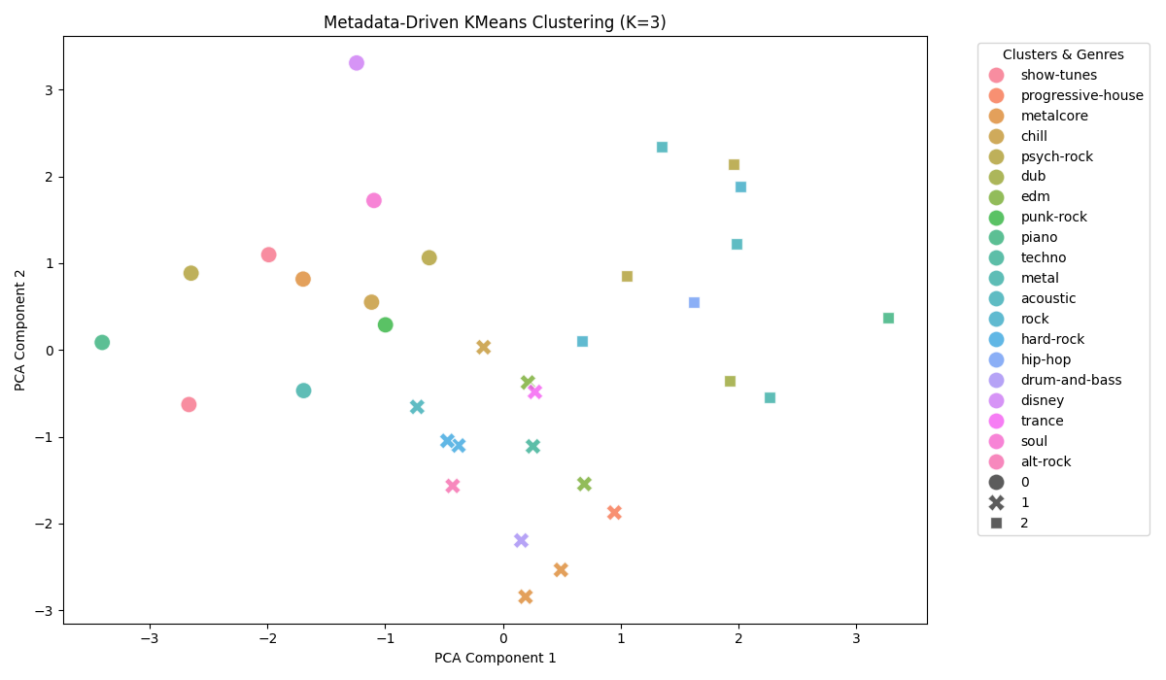
Real User Test: PCA Cluster Visualization (query8_clusters.png)
* 3 distinct vibes clearly separated in 2D PCA space
* Cluster 1 (right): psych-rock/metalcore/metal tracks
o psych-rock, metalcore, metal all share similar sonic fingerprints
* Cluster 2 (down): EDM/Trance/Dub tracks
o Tighter cluster - these genres are more acoustically uniform
* Cluster 3 (left): Bluegrass/Folk/Rockabilly tracks
* PCA Axes represent the compressed 8 audio features
o PC1 likely captures energy/tempo spectrum
o PC2 likely captures acoustic vs electronic dimension
* K=3 was auto-selected
o had 3+ tracks qualifying as distinct genre groups
Music Playlist Recommendation Engine

Slide 18
Dedicated Artist Test (Mix 2): 25x Linkin Park + 25x Beatles
* Query: 50 tracks - 25 Linkin Park (grunge/metal/alternative) + 25 The Beatles (psych-rock/british)
* Vibes Detected: 4 (British, Grunge, Metal, Psych-Rock) - all 4 clusters correctly isolated
* For You Mix top picks (LSTM captures the heavy emotional energy of both artists):
o Ball And Chain by Mike Ness (psych-rock, 1.04)
o Ten Million Voices by Shaman's Harvest (grunge, 1.03)
o New Divide by Linkin Park (grunge, 1.00) - artist bonus: +0.050
* Vibe Mixes generated: British, Grunge, Metal, Psych-Rock
o Linkin Park appears in Grunge mix with +0.050 artist bonus bumping to #3
o Beatles appear in Psych-Rock mix with +0.050 artist bonus
* Dedicated Artist Mixes triggered (threshold: 5+ plays):
o Linkin Park Mix: 10 tracks from discography (New Divide 0.91, Numb 0.81)
o The Beatles Mix: 10 tracks (Night Before 0.87, Sgt. Pepper 0.84, AUSS 0.76)
* Verdict: Artist loyalty system works perfectly for multi-artist heavy sessions
Music Playlist Recommendation Engine

Slide 19
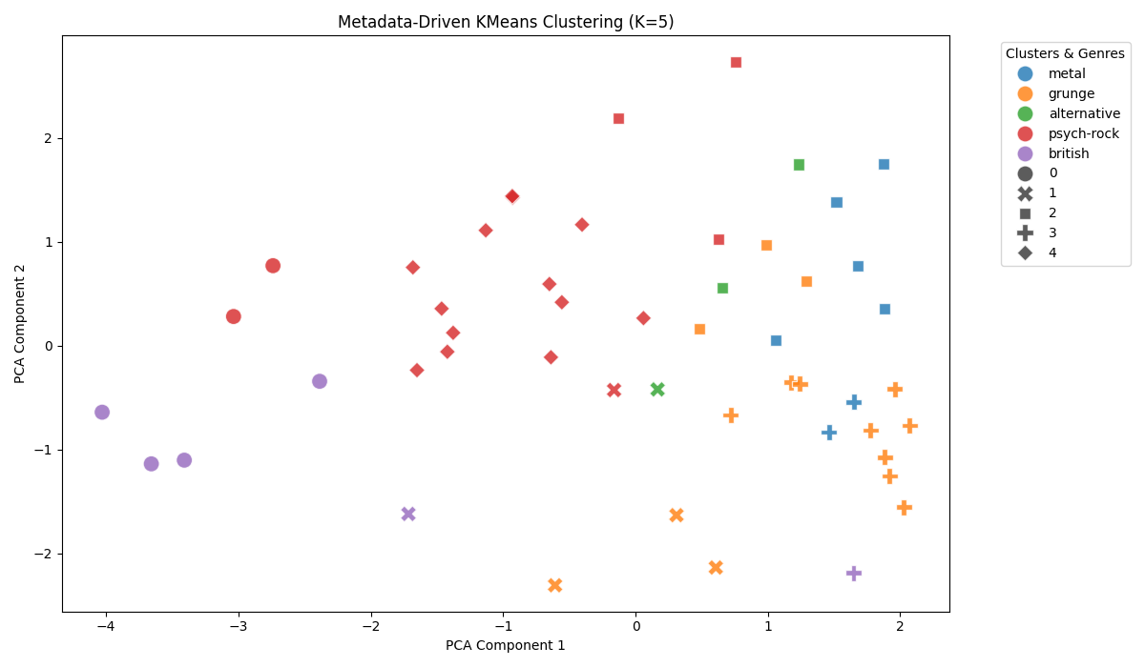
Dedicated Artist Test: PCA Cluster Visualization (query2_clusters.png)
* 4 clearly separated vibe clusters in 2D PCA space
* Cluster 1 (top-left): British cluster
o Beatles british-genre tracks grouped tightly together
* Cluster 2 (top-right): Psych-Rock cluster
o Beatles psych-rock tracks (majority) form large cluster
* Cluster 3 (bottom-left): Grunge/Alternative cluster
o Linkin Park grunge/alternative tracks isolated here
* Cluster 4 (bottom-right): Metal cluster
o Linkin Park metal tracks form their own sub-cluster
* K=4 auto-selected: grunge, metal, psych-rock, british
o all had 3+ tracks qualifying as dominant genre groups
* The clean separation proves the PCA+KMeans engine
o successfully disentangles even closely related genres
Music Playlist Recommendation Engine

Slide 20
Results & Key Achievements
~81,000
114
>30%
40,000+
Unique Tracks in Dataset
Genres Mapped
Dataset Bloat Removed
LSTM Training Sequences
Playlist Generator Capabilities
* Dynamic Vibe Clustering: Detects 1-K distinct listening moods using PCA + KMeans
* For You Mix: Global LSTM-based prediction of the user's next desired musical style
* Genre-Aware Weighting: Weights by local cluster genre distribution (%) - no hardcoded rules
* Dedicated Artist Mixes: Auto-generated if a user plays 5+ tracks from the same artist
* Unplayed Genre Penalty: -0.15 dampening on similar-but-not-played genres
* Regression Test Suite: 6 automated stress-test scenarios run on every CI push
Music Playlist Recommendation Engine

Slide 21
Thank You
Music Playlist Recommendation Engine
Introduction to Data Science . Final Project . Phase 1, 2 & 3
GitHub
Sadra-Madayeni/Music-Playlist-Recommender

